Slide 1
Image Classification

Slide 2
What is in this deck?
Introduction to Computer Vision
What is Image Classification?
A bit about Fast.ai
Chest X-Ray image classification (on Kaggle)
Performance metrics

Slide 3
01
Introduction to Computer Vision

Slide 4

Computer vision is the field of computer science that focuses on replicating parts of the complexity of the human vision system and enabling computers to identify and process objects in images and videos in the same way that humans do
Notes:
https://machinelearningmastery.com/what-is-computer-vision/

Slide 5
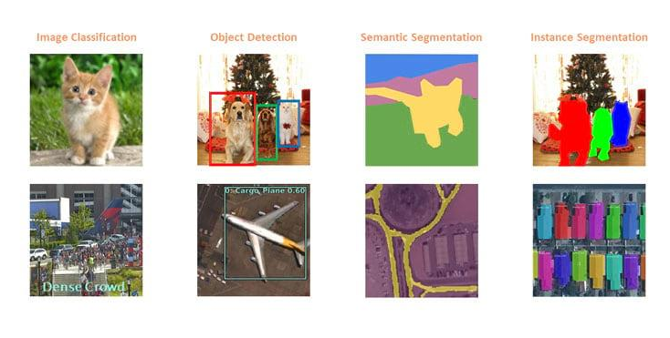
Computer Vision Use Cases
Notes:
https://towardsdatascience.com/everything-you-ever-wanted-to-know-about-computer-vision-heres-a-look-why-it-s-so-awesome-e8a58dfb641e

Slide 6
Applications of CV
CV In Self-Driving Cars
CV In Facial Recognition
CV In Augmented Reality & Mixed Reality
CV In Healthcare

Slide 7
02
What is Image Classification?

Slide 8

Image classification is the task of taking an input image and outputting a class or a probability of classes that best describes the image .
For humans, this task is one of the first skills we learn and it comes naturally and effortlessly as adults
Notes:
https://lipyeow.github.io/ics491f17/morea/deepnn/ImageClassification-CNN.pdf

Slide 9
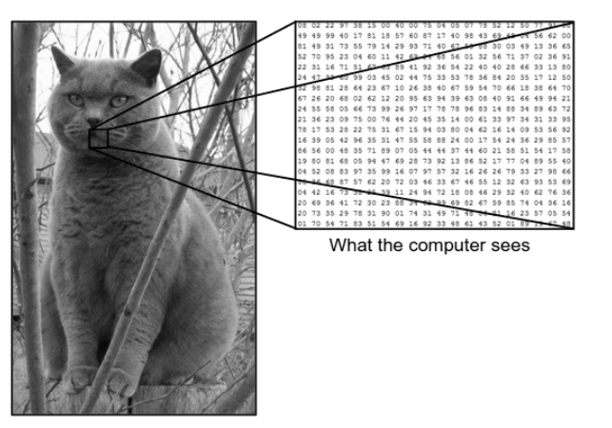
What we see vs. what computer see

Slide 10
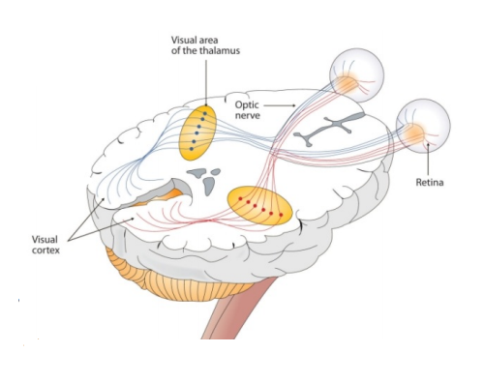
CNN
CNNs take a biological inspiration from the visual cortex
• The visual cortex has small regions of cells that are sensitive to specific regions of the visual field
• For example, some neurons fired when exposed to vertical edges and some when shown horizontal or diagonal edges
• Having the neuronal cells in the visual cortex looking for specific characteristics is the basis behind CNNs

Slide 11
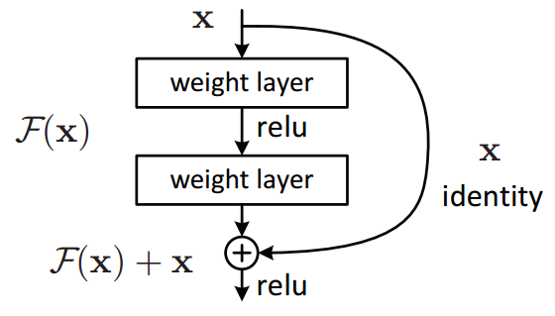
ResNets
In 2015 during ILSVRC 2015 author Kaiming He, et al. came up with this amazing architecture which was high performing and eventually helped them win the competition. ResNets have a very intiutive explanation. Up till now we were trying to convert input to output, but in this case we try to find the difference between input and output.
R(x) = Output — Input = H(x) — x
Is similar to writing as
H(x) = R(x) + x
So, instead to reducing input to output we try to “ map input to output by the difference between the two. ”
We will be using Resnet34
Notes:
https://towardsdatascience.com/an-overview-of-resnet-and-its-variants-5281e2f56035
https://medium.com/@georgezhang_33009/how-to-make-the-most-of-the-top-down-fast-ai-courses-ae70814c736f

Slide 12
03
A bit about Fast.ai

Slide 13
fastai is a deep learning library which provides practitioners with high-level components that can quickly and easily provide state-of-the-art results in standard deep learning domains, and provides researchers with low-level components that can be mixed and matched to build new approaches. It aims to do both things without substantial compromises in ease of use, flexibility, or performance.
Notes:
https://www.fast.ai/

Slide 14
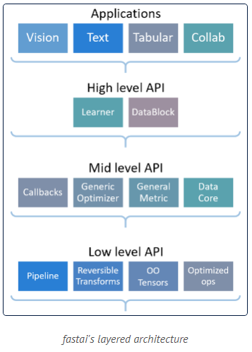
Layered Architecture of fastai

Slide 15
So, Let’s move onto to Kaggle for a demo!
Link : https://www.kaggle.com/aarshibhatt112/chest-x-ray-classfication-using-fast-ai
Notes:
https://towardsdatascience.com/deep-learning-image-classification-with-fast-ai-fc4dc9052106

Slide 16
04
Performance metrics

Slide 17
The effectiveness of a model is assessed through a number of techniques applied on previously unseen data (test data).
These techniques are called a performance metrics

Slide 18
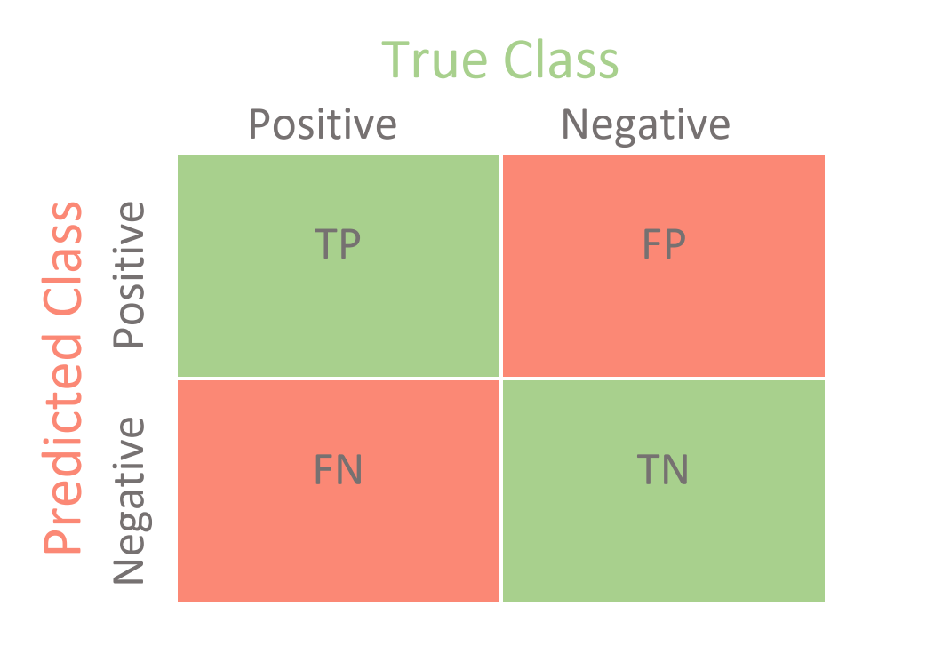
Confusion Matrix
The Confusion matrix in itself is not a performance measure as such, but almost all of the performance metrics are based on Confusion Matrix and the numbers inside it.
Notes:
https://medium.com/@MohammedS/performance-metrics-for-classification-problems-in-machine-learning-part-i-b085d432082b#:~:text=We%20can%20use%20classification%20performance,(Area%20under%20Curve)%20etc.&text=The%20metrics%20that%20you%20choose,algorithms%20is%20measured%20and%20compared.

Slide 19
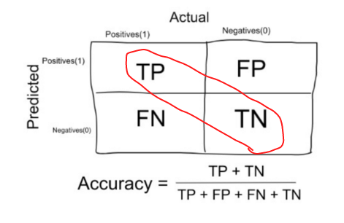
Accuracy:
When to use Accuracy:
Accuracy is a good measure when the target variable classes in the data are nearly balanced.
When NOT to use Accuracy:
Accuracy should NEVER be used as a measure when the target variable classes in the data are a majority of one class.

Slide 20
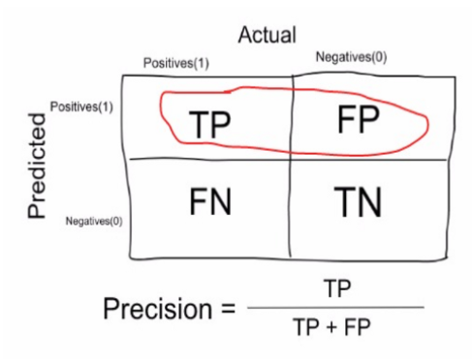
Precision:
Precision measure tell upto what extent the prediction is actually true ( or let’s say what proportion of patients that we diagnosed as having cancer, actually had cancer )

Slide 21
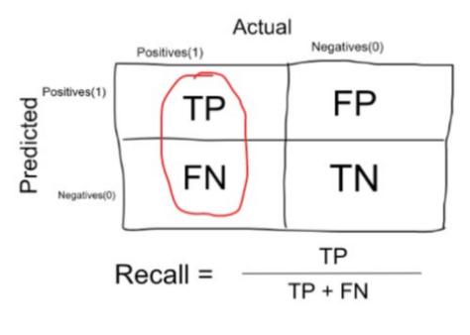
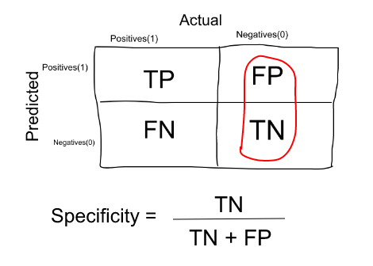
Recall or Sensitivity
Recall is a measure that tells us what proportion of patients that actually had cancer was diagnosed by the algorithm as having cancer.
Specificity
Specificity is a measure that tells us what proportion of patients that did NOT have cancer, were predicted by the model as non-cancerous

Slide 22
Time for some questions!!!

Slide 23
Some resources
https://course.fast.ai/
zerotogans.com
https://towardsdatascience.com/intuitively-understanding-convolutions-for-deep-learning-1f6f42faee1
https://www.kaggle.com/learn/overview
http://introtodeeplearning.com/
https://www.kaggle.com/general/63077

Slide 24
Thank you!

